Slide 1


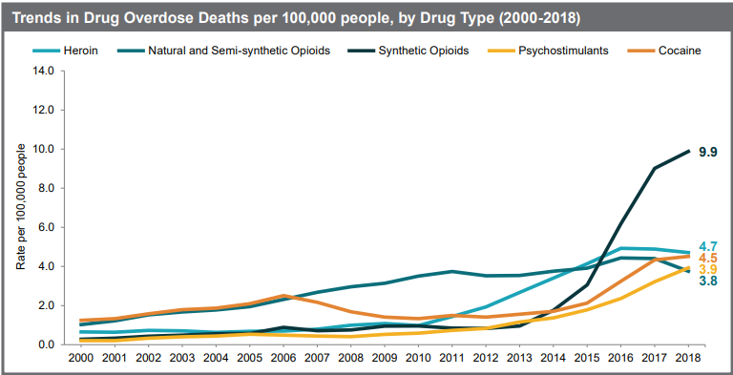
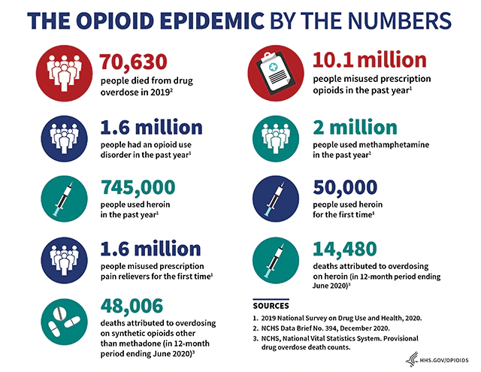
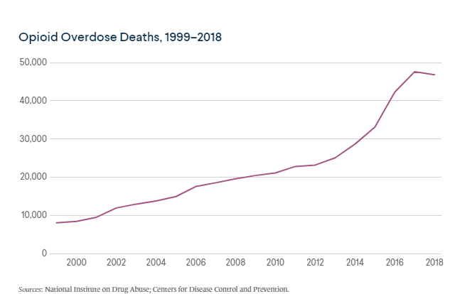
The Opioid Epidemic: The Crisis and Solutions
Fabiola Nina, , MCPHS University, School of Arts and Sciences, Pre Med and Health Sciences Program
Introduction/Background
Current Initiatives to Address the Problem
The United States is battling with one of the worst substance abuse crisis; the opioid crisis. Since the start of the new millennium in 2000, the number of deaths related to drug overdose has significantly risen up to more than 60000 death in 2019. While this deaths are caused by general substance abuse, most of them are caused by opioids including synthetic opioids such as fentanyl, prescription painkillers and heroin.
The opioid crisis has become an economic burden costing the United States an estimated $80 billion annually in addiction treatment, cost of healthcare, criminal justice involvement and lost productivity.
The opioid crisis is not only affecting the economic but it become a threat to national security and a public health concern affecting the United States (DeWeerdt, 2019).
Measures that have been undertaken to address the issue including improving access to recovery and treatment services, promoting the use of overdose reversing medications, advancing better pain management practices, improving public health surveillance to improve our understanding of the crisis and providing support for research on the pain medication and people’s addiction to it. (Wickramatilake et al., 2017) Additionally, the federal government has provided counter narcotics aid to the countries where drugs such as heroin originate from to the United States for instance, Colombia and Mexico.
Further research should be on the pain and addiction to inform development of effective measures to address the opioid epidemic and advance better practices for pain management.
Conclusion
Body
The Opioid epidemic has caused devastating consequences becoming an economic burden, national security threat and public health concern prompting efforts to address the issues. As a public health concern, the opioid crisis has significantly increased opioid dependence on these drugs which has disrupted their normal operations. Additionally it has increased spread of infectious diseases due to the use of shared syringes.
The United States government spends a high cost to provide healthcare. According to Thakur et al. (2019), the opioid epidemic has caused a declining work force participation with statistics indicating up to 20% decline in labor force participation among men and up to 25 among women in the last 2 decades. As a national security threat, opioids such as heroin are produced in Mexico and Colombia by criminal organizations that are a threat to the united States.
In the late 20th century, pharmaceutical companies and journal publications reassured the medical community that opioids were effective pain relievers without high risk addiction for the patients which led to increased prescription rates (DeWeerdt, 2019).
Increased opioid medication prescription led to widespread misuse and diversion of these medications before they became clear to be highly addictive.
A report by the National Survey on Drug Use and Health (2020) show more than 10 million people aged 12 years and above abused opioids in 2019. Particularly, 9.7 million people abused prescription pain medication while 745000 people used heroin.
Appropriate opioid prescription and use is essential to protecting and promoting individual health and safety.
The dynamics of the opioid epidemic vary widely in the United States with diverging trends and varying overdose rates increasing and decreasing the negative consequences of the crisis (Rothstein, 2017).
The opioid epidemic has become a public health crisis with adverse consequences. The opioid misuse through various forms such as injection has contributed to the increase in the spread of infectious diseases such as hepatitis C and HIV.
The Prevalence of Opioid Abuse
References
DeWeerdt, S. (2019). Tracing the US opioid crisis to its roots. Nature, 573(7773), S10-S10.
Rothstein, M. A. (2017). The opioid crisis and the need for compassion in pain management.
National Survey on Drug Use and Health. (2020). Key substance use and mental health indicators in the United States: Results from the 2019 national survey on drug use and health.
Thakur, T., Frey, M., & Chewning, B. (2019). Pharmacist services in the opioid crisis: current practices and scope in the United States. Pharmacy, 7(2), 60.
Wickramatilake, S., Zur, J., Mulvaney-Day, N., Klimo, M. C. V., Selmi, E., & Harwood, H. (2017). How states are tackling the opioid crisis. Public Health Reports, 132(2), 171-179.

